Slide 1

Procurement Analytics
Transforming 5,200 Purchase Orders into Strategic Insights
FY 2022 - 2024 Strategic Reporting

Slide 2


STRATEGIC PROJECT OVERVIEW
The Core Challenge
Analytical Objectives
Modern procurement faces volatility: rising costs, supplier delivery risks, and compliance gaps. Our current P2P cycle shows friction in invoice matching and maverick spending which strains annual budgets.
Evaluate 3+ years of transaction data to gain visibility into spending patterns, monitor supplier performance KPIs, track contract effectiveness, and mitigate operational risks.

Slide 3






THE ANALYTICAL FOUNDATION
5,200 Orders
57 Data Fields
$908.8M Spend
Complete historical transaction records from 2022 through 2024.
Rich metadata including Supplier Tiers, ESG scores, and Contract IDs.
Managed expenditure analyzed for savings and cost avoidance opportunities.

Slide 4
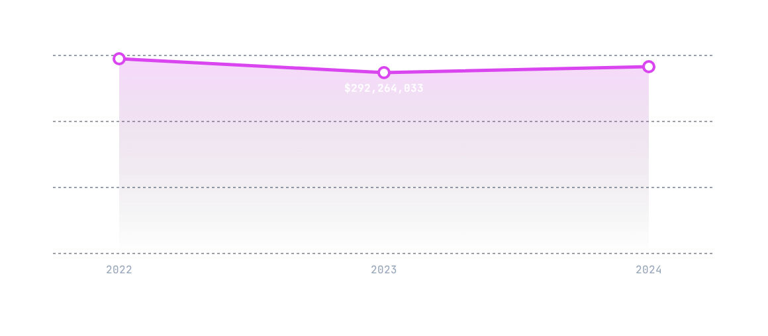
HISTORICAL SPEND TRENDS

Slide 5
EXPENDITURE & BUDGET DEVIATION
Category | Total Spend | Total Budget | Difference | Variance (%)
IT Software | $299,551,458 | $335,363,187 | -$35,811,729 | -10.68%
Professional Svcs | $163,883,292 | $184,514,931 | -$20,631,639 | -11.18%
Marketing | $137,517,425 | $151,630,295 | -$14,112,870 | -9.31%
IT Hardware | $117,048,532 | $129,736,172 | -$12,687,640 | -9.78%
HR & Training | $90,254,182 | $99,336,152 | -$9,081,970 | -9.14%

Slide 6
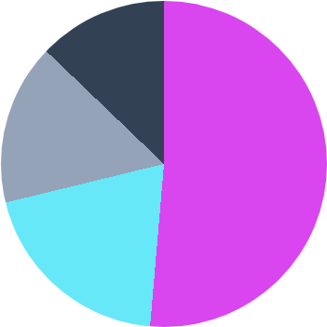
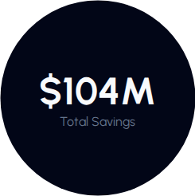
NEGOTIATION EFFECTIVENESS
Spot Contracts (51.36%)
Long-term (19.83%)
Framework (15.98%)
Master Supply (12.83%)
Insight: Over-reliance on Spot contracts suggests potential for deeper strategic negotiation in Long-term agreements.

Slide 7


THE PREFERRED SUPPLIER PARADOX
Non-Preferred Suppliers ($604M Total Spend) 8.7% Savings
Preferred Suppliers ($304M Total Spend) 8.08% Savings
Structural Anomaly
Recommendation
Non-preferred vendors have higher ESG scores (61.84 vs 57.25) and faster delivery (3 days late vs 4 days for preferred).
Upgrade high-performing non-preferred vendors to strategic priority status to formalize high-value relationships.

Slide 8

OTIF PERFORMANCE
Delivery Realities
Overall average on-time delivery rate sits at only 64.13%. Even tier-1 logistics partners average 3-5 days late on major orders.
Contract type influences speed: Long-term contracts show slightly better lead times (35 days) vs Framework (36 days).
Strategic shift required: Integrate financial penalties into SLAs for delivery rates falling below 65%.

Slide 9


P2P COMPLIANCE RISKS
10.8%
26.3%
15.5%
Maverick Spend
Unmatched Invoices
Overdue Payments
$98.19M bypassed approval
Severe payment risk indicator
Straining supplier relationships

Slide 10


URGENT RISK NOTIFICATION
Atlantic Raw Materials
Vendor ID: SUP-011 (Risk: High)
16 Red-Flagged Orders currently in system.
$6.2M Unpaid/Disputed amounts pending.
Represents 19.8% of total department payment risk.
ACTION REQUIRED: IMMEDIATE ACCOUNT RECONCILIATION

Slide 11
STRATEGIC RECOMMENDATIONS
Supplier Optimization: Upgrade non-preferred vendors with high ESG and savings rates to strategic status.
Renegotiate Contracts: Shift volume to Long-term contracts with tiered discounts to reduce Spot dependency.
Tighten P2P Controls: Implement ERP hard stops for PO approval to reduce Maverick Spend below 5%.
Automated Risk Dashboard: Deploy real-time tracking for budget deviations and seasonal spending spikes.
Update SLA Terms: Incorporate financial penalties for OTIF rates consistently falling below 65%.

Slide 12
Questions?
Procurement Analytics Strategic Report

